Slide 1
Hash Learning
Jia-Hong,Huang
04/27/2017

Slide 2
Agenda
1. Introduction and background.
2. Evaluation protocols in Hash Learning.
3. Five problems for computing hash codes.
4. Four main categories of Hash Learning.
5. Deep Hash Learning.
6. Conclusion.

Slide 3
Introduction and background
What is Learning to Hash?
Exact Nearest Neighbor Search
Approximate Nearest Neighbor (ANN) Search
4. ANN search by hashing approach

Slide 4
What is Learning to Hash?
Learning to hash is a data-dependent hashing approach which aims to learn hash functions from a specific dataset so that the nearest neighbor search result in the hash coding space is as close as possible to the search result in the original space, and the search cost and the space cost are also small. The main methodology of learning to hash is similarity preserving.
Note: The other main category hashing algorithm is Locality Sensitive Hashing (LSH) which is
data-independent hashing approach. LSH is not the today’s focus.

Slide 5
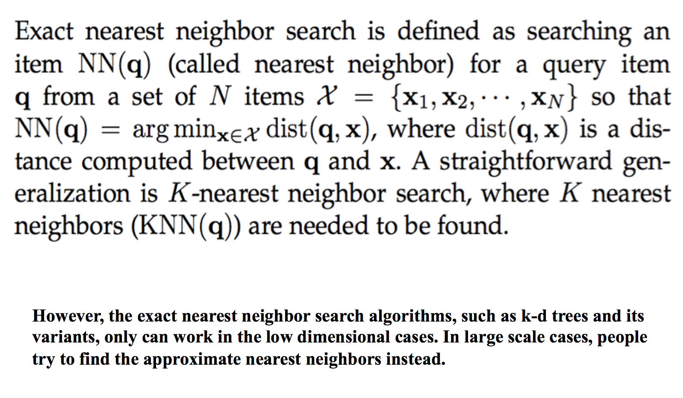
Exact Nearest Neighbor Search

Slide 6
Approximate Nearest Neighbor (ANN) Search (for large scale cases)
Error-constrained nearest neighbor search
(Including ANN search by hashing approach, approximate fixed-radius near neighbor, and so on.)
2. Time-constrained nearest neighbor search
(Mostly for real applications, but usually lack elegant theories.)

Slide 7
ANN search by hashing approach
1. Hash table lookup
2. Hash code ranking

Slide 8
Hash table lookup
The main idea of hash table lookup for accelerating the search is to reduce the number of the distance computations.
The data structure, called hash table (a form of inverted index), is composed of buckets with each bucket indexed by a hash code. Each reference item x is placed into a bucket h(x).
Note: Hash table lookup is mainly used in locality sensitive hashing (LSH).

Slide 9
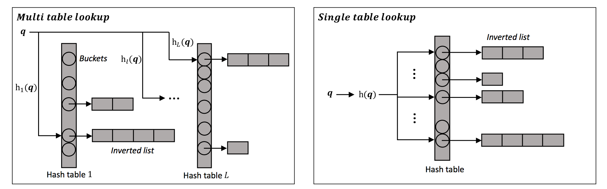

Slide 10
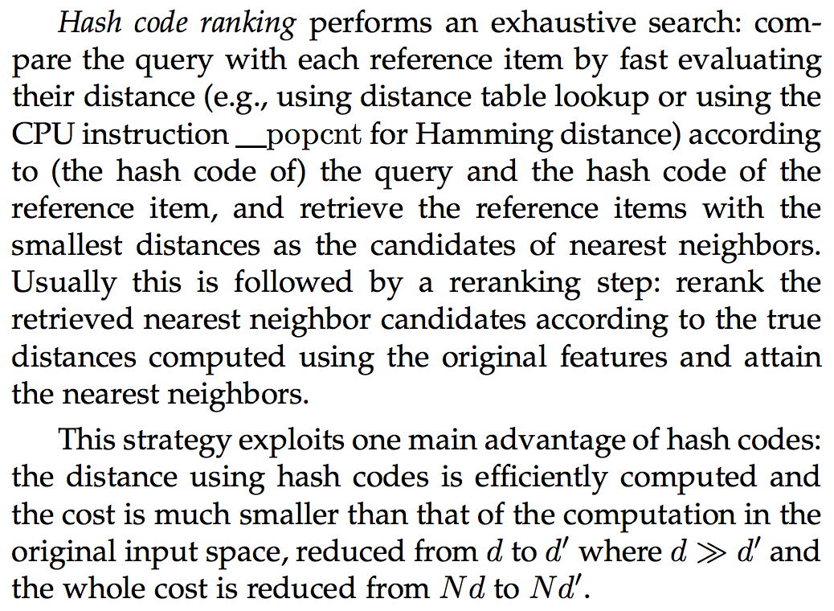
Hash code ranking

Slide 11
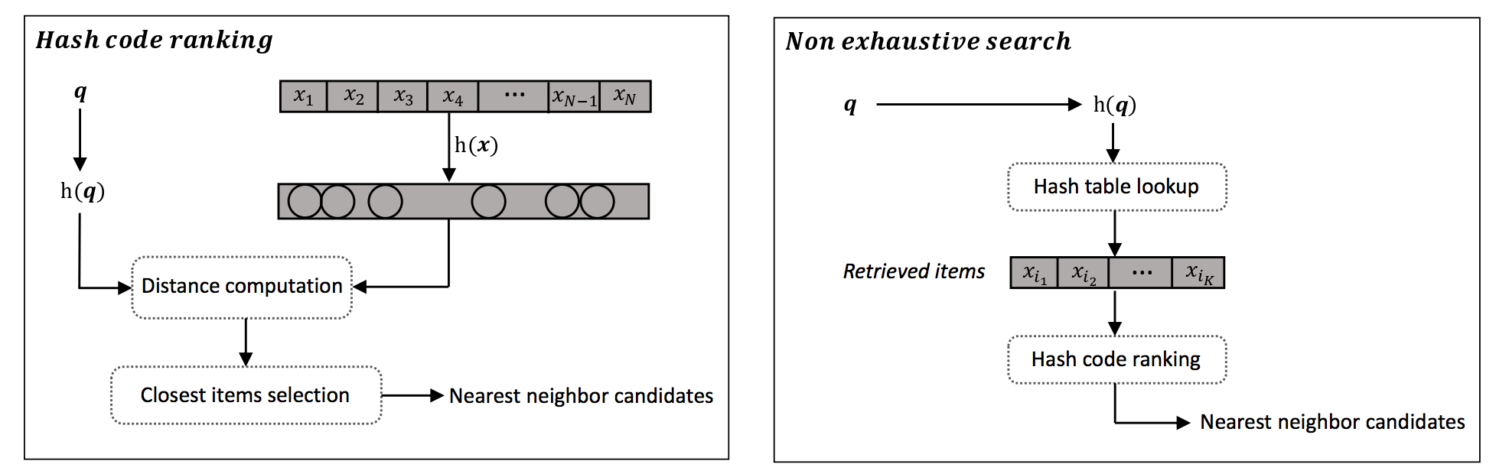

Slide 12
Evaluation protocols in Hash Learning
Evaluation Metrics (for search quality)
Evaluation Datasets
Note: In approximate nearest neighbor search algorithm, we care about
three things: space cost, search efficiency and search quality.
Notes:
Space cost depends on the code length.
Search efficiency is measured as the time taken to return the search result for a query.

Slide 13
Evaluation Metrics (for search quality)
Precision
Recall
Precision-Recall curve
Mean Average Precision (MAP)

Slide 14
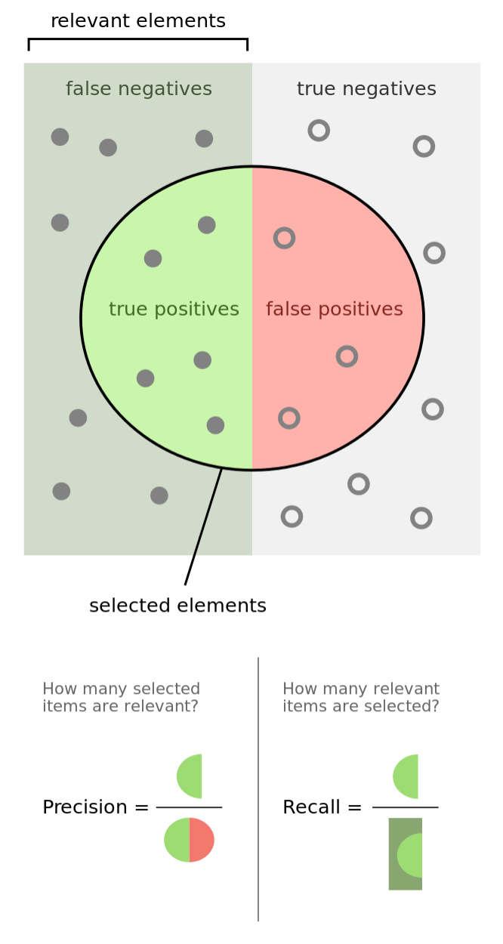
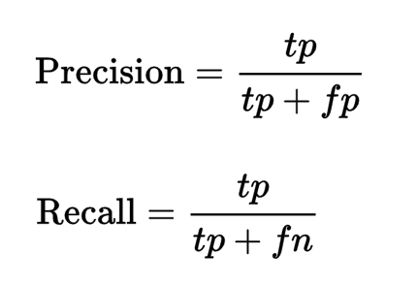
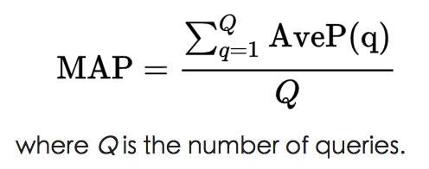
1. https://en.wikipedia.org/wiki/Precision_and_recall
2. https://en.wikipedia.org/wiki/Information_retrieval

Slide 15
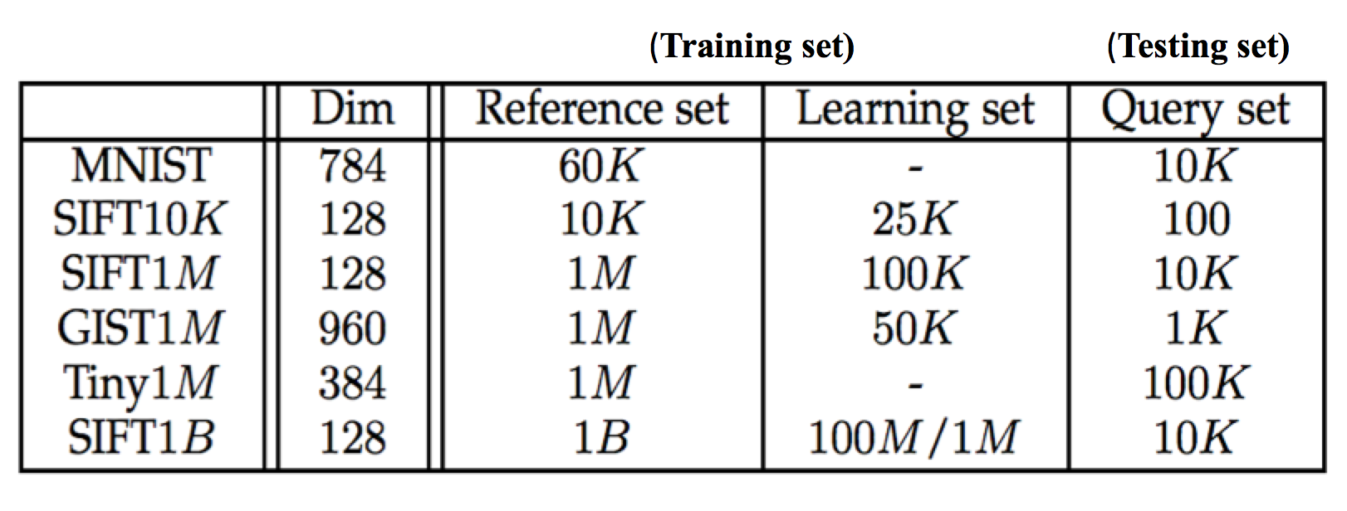
Evaluation Datasets

Slide 16
Five problems for computing hash codes
1. What hash function is adopted?
2. What similarity in the hashing space is used?
3. What similarity in the original space is provided?
4. What loss function is chosen for the optimization objective?
5. What optimization techniques are adopted?

Slide 17
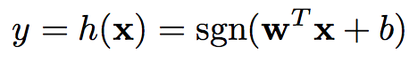
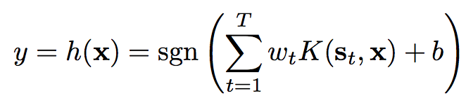
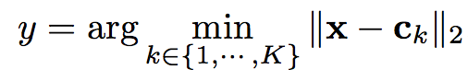
What hash function is adopted?
1. Linear hash function (efficiently):
sgn(z)=1 if z>=0, and sgn(z)=0 (or -1) if z<0.
w is the projection vector and b is the bias variable.
2. Kernel hash function (better accuracy, flexible):
{St} is a set of representative samples that are randomly drawn from the dataset or cluster centers of the dataset and {Wt} are the weights. K( , ) is a kernel function
3. Non-parametric function (better accuracy, flexible):
{C1, … , CK} is a set of centers computed by some algorithms, such as K-means, and y is an integer.
4. Spherical function, (deep) neural networks, and so on.
Note: The form of hash function is an important factor influencing the search accuracy using the hash codes, as well as the time cost of computing hash codes.

Slide 18
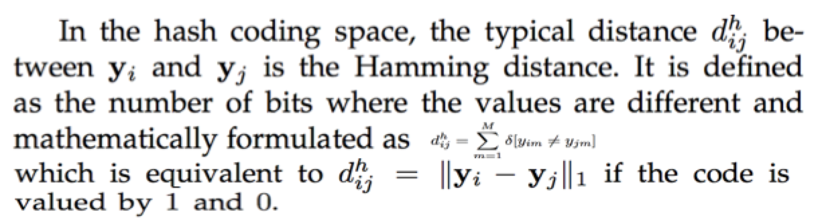
What similarity in the hashing space is used?
In the hashing (coding) space:

Slide 19
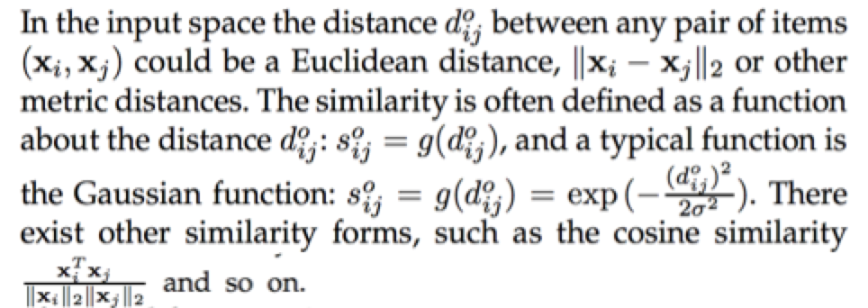
What similarity in the original space is provided?
In the original (input) space:

Slide 20
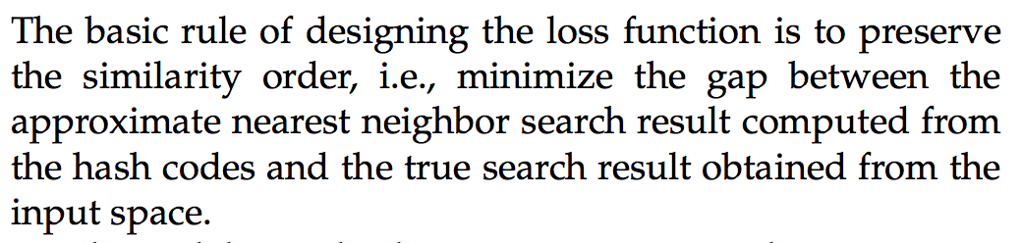
What loss function is chosen for the optimization objective?
Note: We will see many examples later.

Slide 21
What optimization techniques are adopted?
I.
The challenges for optimizing the hash function parameters lie in two main factors. One is that the problem contains the sgn() function, which leads to a challenging mixed-binary-integer optimization. 1. Continuous relaxation: this is the most widely-adopted way, including sigmoid relaxation sgn(z) --> sigmoid(z) and sgn(z) --> z (i.e., drop the sgn() directly). 2. Two-step scheme with its extension to alternate optimization: optimizing the binary codes without considering the hashing, following by estimating the function parameters from the optimized hash codes. 3. Transforming the problem into a latent structure-SVM, and so on.
II.
The other challenge is that the time complexity is high when processing a large number of data points, which is usually handled by sampling a subset of points or a subset of constraints (or equivalent basic terms in the objective functions).

Slide 22
Four main categories of Hash Learning
1. Pairwise similarity preserving.
2. Multiwise similarity preserving.
3. Implicit similarity preserving.
4. Quantization.

Slide 23
Pairwise similarity preserving
1. Similarity-Distance Product Minimization
2. Similarity-Similarity Product Maximization
3. Distance-Distance Product Maximization
4. Distance-Distance Difference Minimization
5. Similarity-Similarity Difference Minimization
6. Distance-Similarity Product Minimization

Slide 24
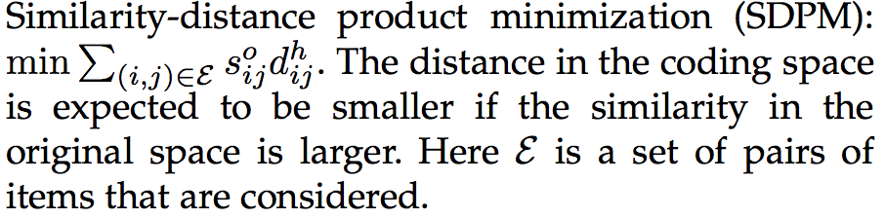
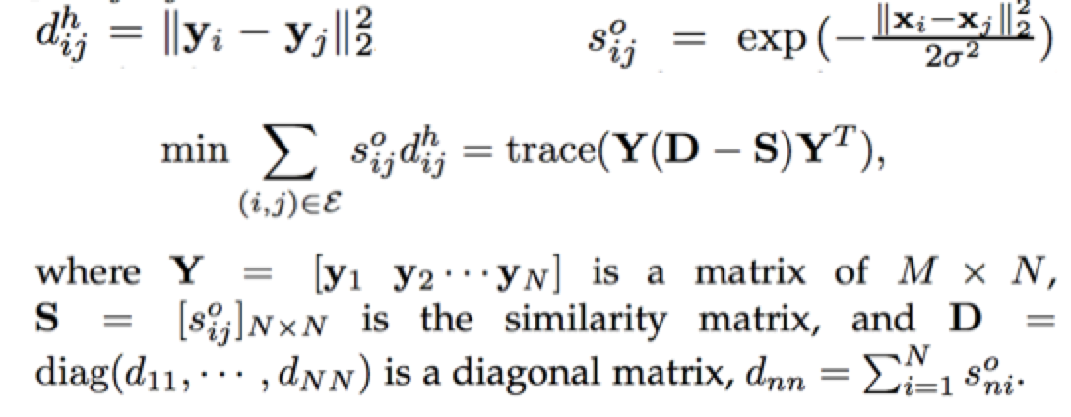
Similarity-Distance Product Minimization
In this category, we call it Spectral Hashing and its extension.

Slide 25
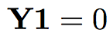
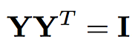
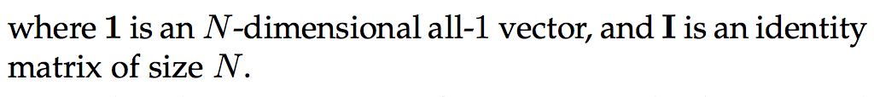
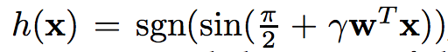
Similarity-Distance Product Minimization
We have to avoid the trivial solution, y1 = y2 = … = yN .
So, we add the following two conditions.
Bit-balance condition:
Bit-uncorrelation condition:
Note: The extensions of spectral hashing are not the focus of today.

Slide 26
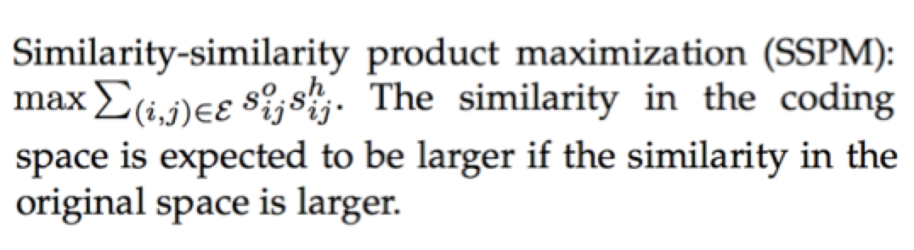
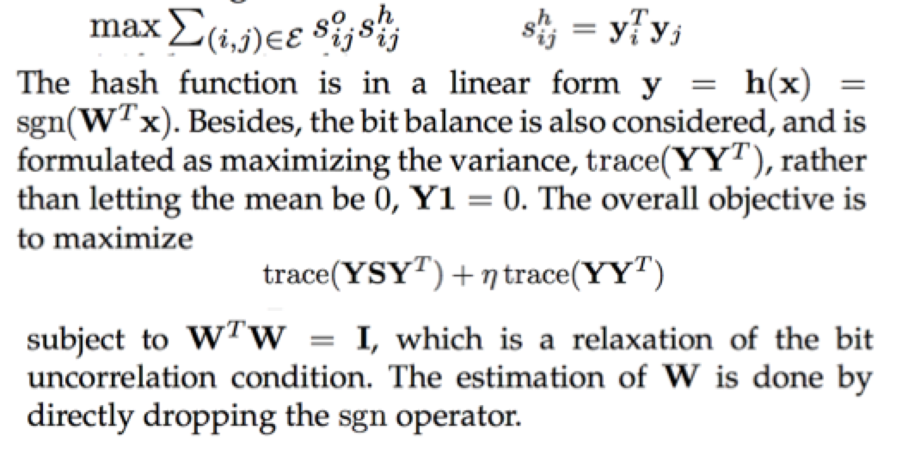
Similarity-Similarity Product Maximization
In this category, we call it Semi-Supervised Hashing.

Slide 27
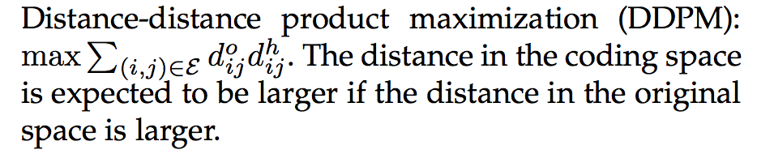
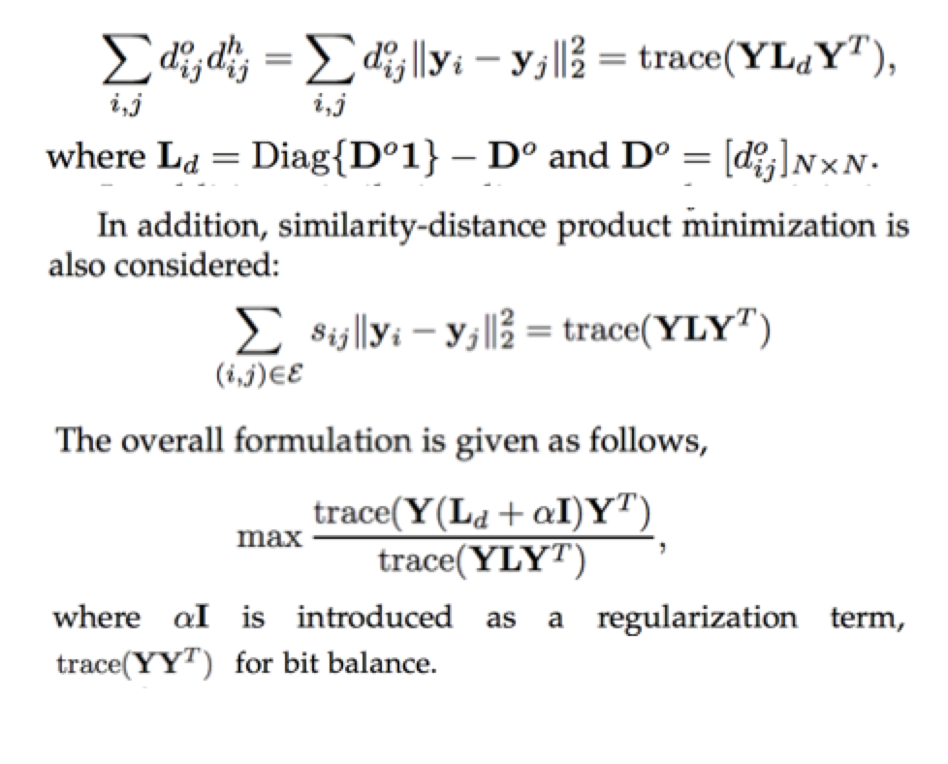
Distance-Distance Product Maximization

Slide 28
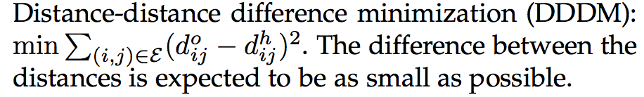
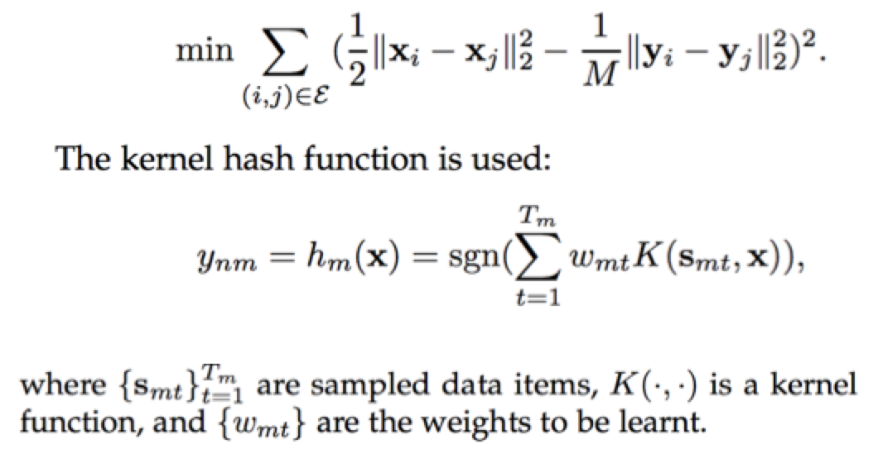
Distance-Distance Difference Minimization
In this category, we call it Binary reconstructive embedding.

Slide 29
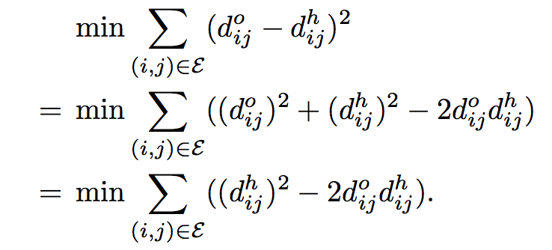
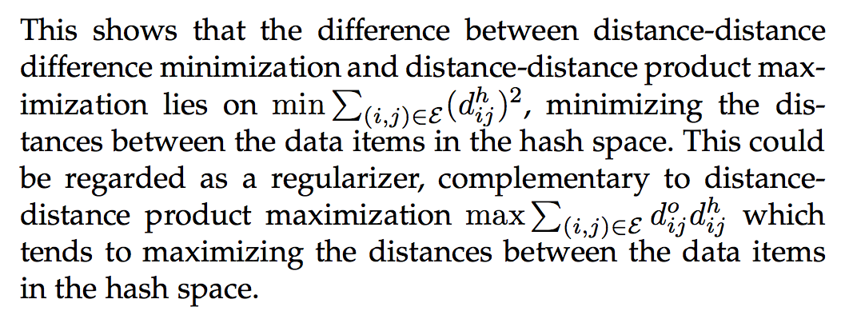
DDDM V.S. DDPM

Slide 30
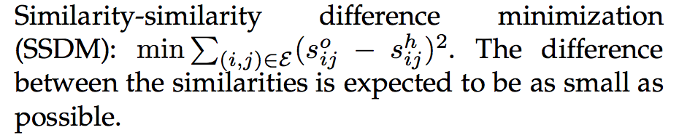
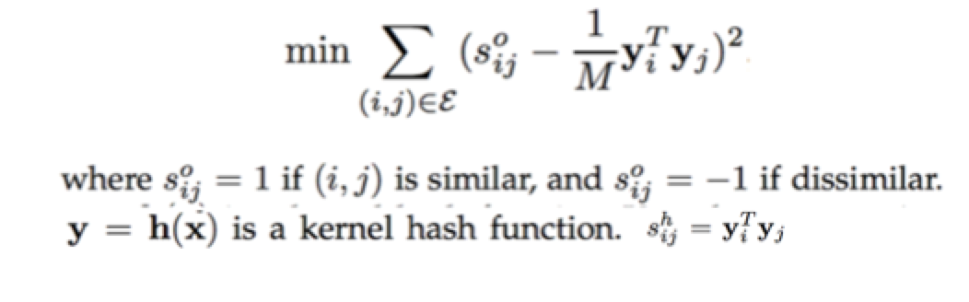
Similarity-Similarity Difference Minimization
In this category, we call it Supervised Hashing with Kernels.

Slide 31
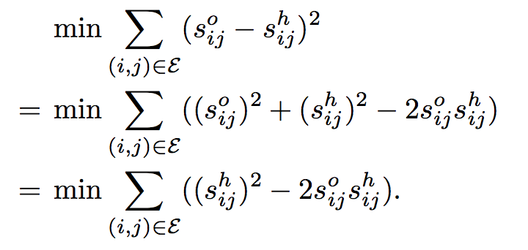
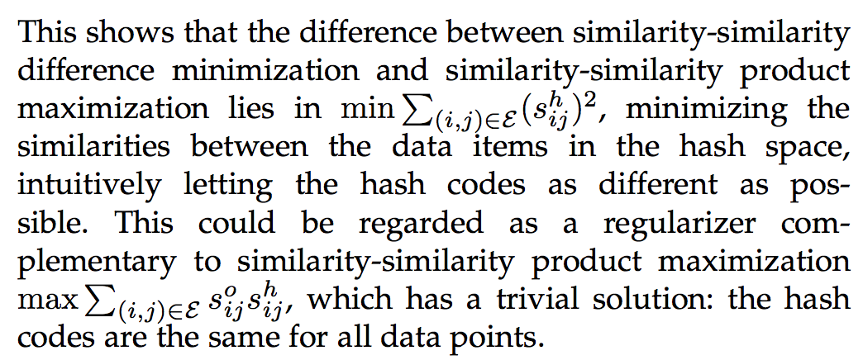
SSDM V.S. SSPM

Slide 32
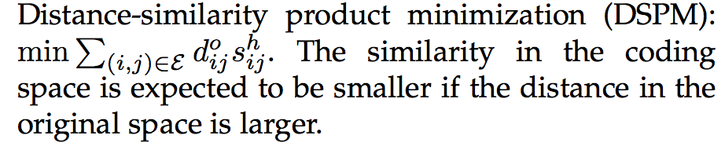
Distance-Similarity Product Minimization
Note: No specific algorithm belongs to this category.

Slide 33
Multiwise similarity preserving
In this category of hashing algorithms, they formulate the loss function by maximizing the agreement of the similarity orders over more than two items computed from the input space and the coding space.

Slide 34
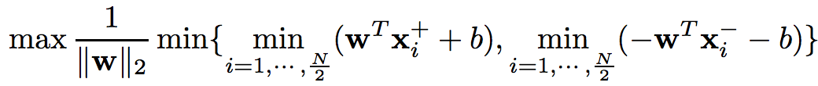
Implicit similarity preserving
In this category, the hashing algorithms focus on pursuing effective space partitioning without explicitly evaluation the relation between the distance/similarities. The common idea is to partition the space, formulated as a classification problem, with the maximum margin criterion or the code balance condition.
The formulation is a standard SVM formulation that is equivalent to the following form:
Notes:
X+ positive example
X- negative example

Slide 35
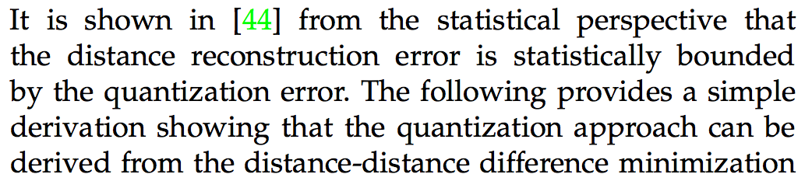
Quantization
[44] http://ieeexplore.ieee.org/abstract/document/5432202/?reload=true

Slide 36
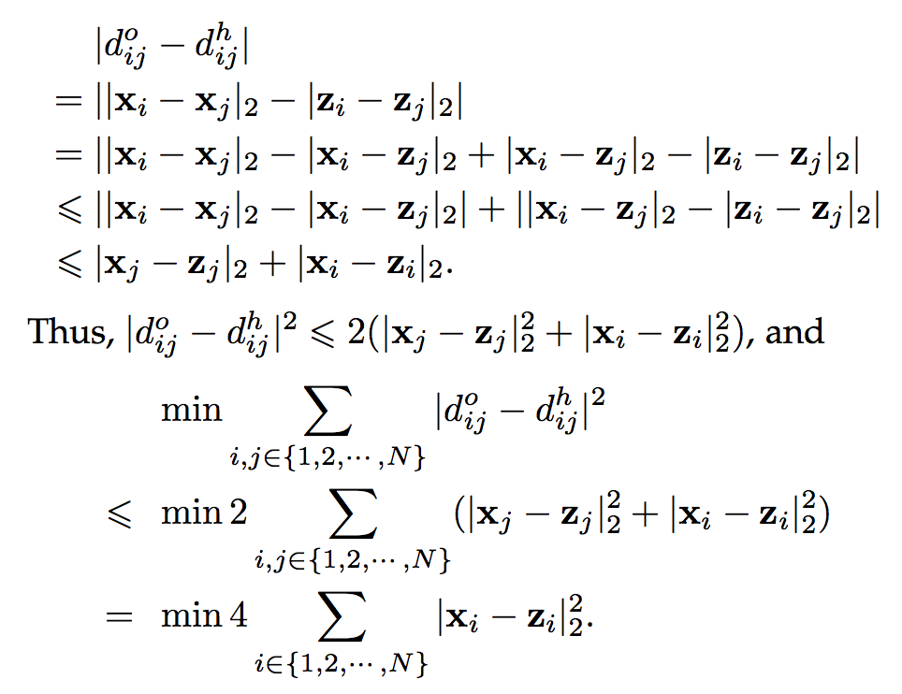
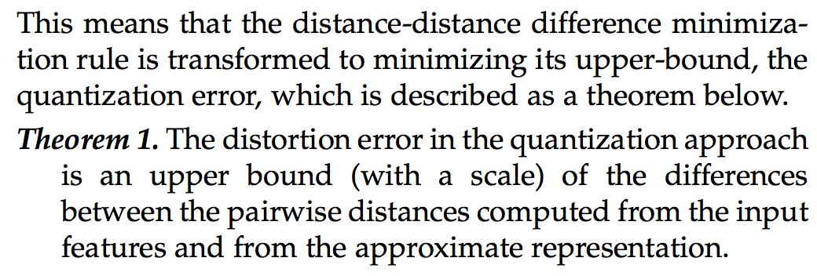
Quantization

Slide 37
Quantization
1. Hypercubic Quantization
Iterative Quantization and its extensions
2. Cartesian Quantization
Product Quantization
Composite Quantization

Slide 38
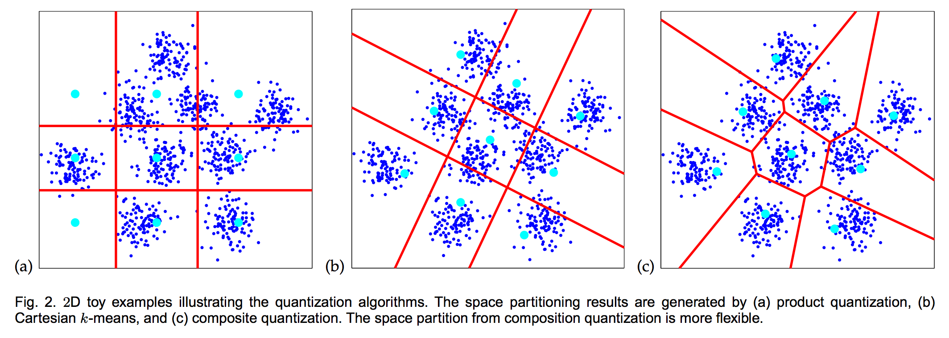

Slide 39
Deep Hash Learning
Typically, the approaches simultaneously learn the representation using a deep neural network and hashing functions under some loss functions, rather than separately learn the features and then learn the hash functions.
The methodology is similar to hashing algorithms that do not adopt deep learning, and the hash function is more general and could be a deep neural network.
Note: This is relatively new research direction in Learning to Hash.

Slide 40
Conclusion
Time is money.
Learning to Hash can help you earn money in the big data era.
Thank you!

